Slide 1
Library Management System
Submitted to: Submitted by:
Silviya Paskaleva Tarun Reddy Amanolla 1993173
Abiakashjeet Singh 1993113
Navneet Kaur 1995430
Amandeep Kaur 1994866

Slide 2
INTRODUCTION
The Library Management System is a Library Management software for monitoring and controlling the transactions in a library.
Library Management System supports the general requirement of the library such as the Acquisitions (ordering, receiving), categories, circulation and other sections.

Slide 3
PURPOSE
The main purpose of this project is to develop a computerized system that will manage the activities in the library thereby providing easy access of library usage for librarian and users of the library, it will also help librarians keep track of library information etc. This system will also provide electronic means of storage and help librarians keep track of library information.

Slide 4
SCOPE
Create distinct product users based on their roles and permissions.
Provide the list of books the users can borrow.
Facility to reserve books that are available.
A status page for all users to view books reserved by them.
Facility to cancel the reservation for a book made earlier.
A status page for all users to view books borrowed by them, their individual due dates and their individual penalties

Slide 5
GENERAL DESCRIPTION
The purpose of this application is to maintain the records of books in the library. Students and teachers can easily access the books according to the departments.

Slide 6
PROJECT FUNCTIONS
LMS is a network of computers that uses a certain program to facilitate technical functions of the library. With LMS, library users can trace desired items electronically without going through shelves.LMS also facilitates the lending process by keeping records of items add and borrowers information.

Slide 7
USER CHARACTERISTICS
Type of Users:
Library Manager
Librarian
Library User
Library Manager
1.Good understanding to library operation.
2.Responsible for library operation as a whole.
Librarian
1.Good understanding to library operation.
2.Responsible for library operation.
Library User
1. Student and Faculty tends to find books in their specification and download material.

Slide 8
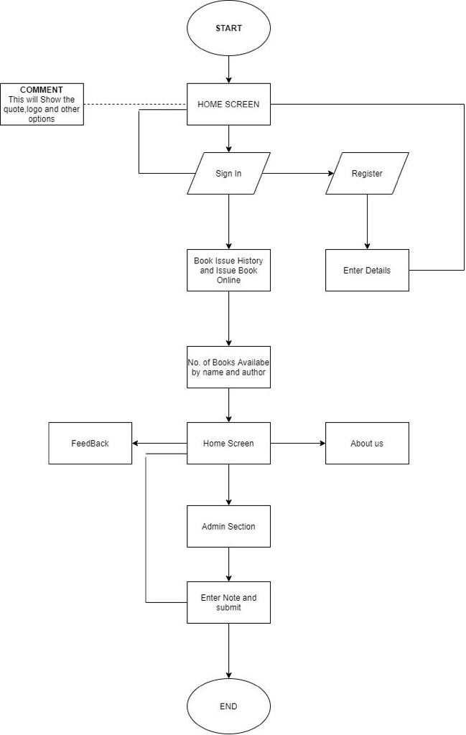
ANALYSIS MODELS Flow Chart

Slide 9
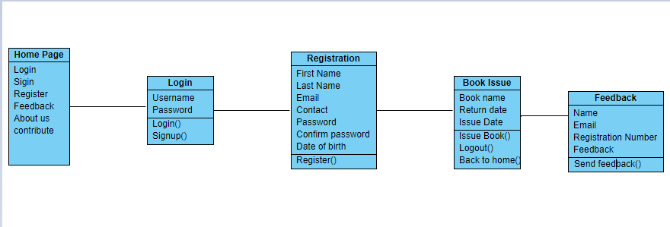
Class Diagram

Slide 10
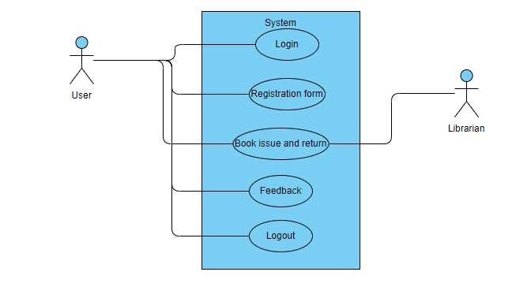
Usecase Diagram

Slide 11
CONTENT
Home Page
Login
Registration Form
Book Issue and return
Feedback
Logout

Slide 12
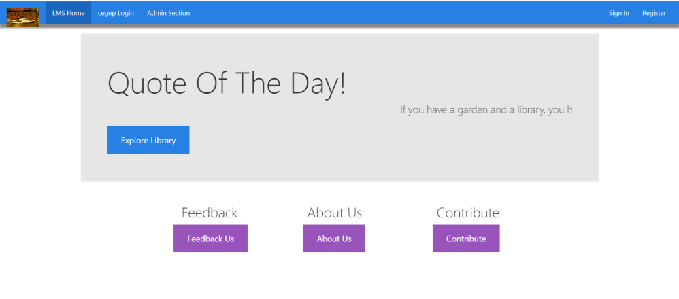
Home Page

Slide 13

Login

Slide 14
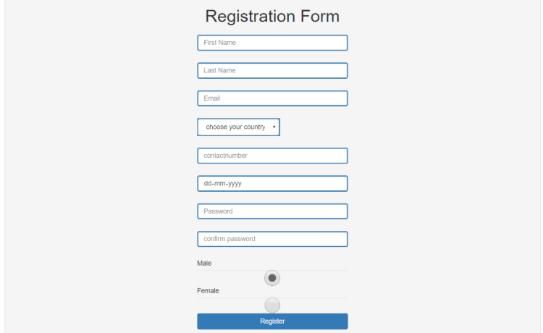
Registration Form

Slide 15
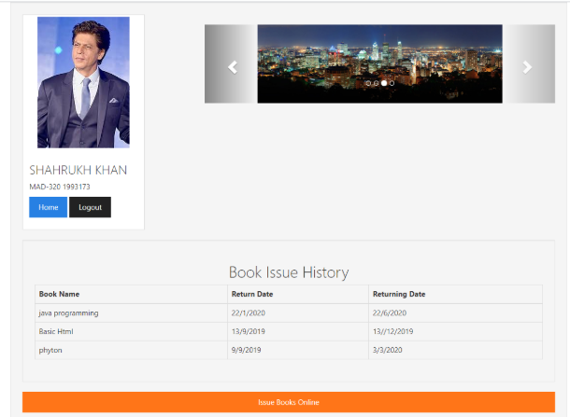
Book Issue and return

Slide 16
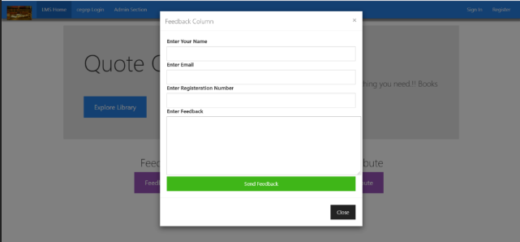
Feedback

Slide 17
Logout

Slide 18
Conclusion
In conclusion, from proper analysis and assessment of the designed system it can be safely concluded that the system is an efficient, usable and reliable Library Management System. It is working properly and adequately meets the minimum expectations that were for it initially . The new system is expected to give benefits to the users and staff in terms of efficiency in the usage of library system.

